Slide 1
Object Detection
J.P. Li
ShanghaiTech University
lijp@shanghaitech.edu.cn

Slide 2
Note about hw1
Check out note@13 on your piazza
PDF->Gradescope, code->github classroom
DDL: Oct. 15, 23:59, 2021

Slide 3
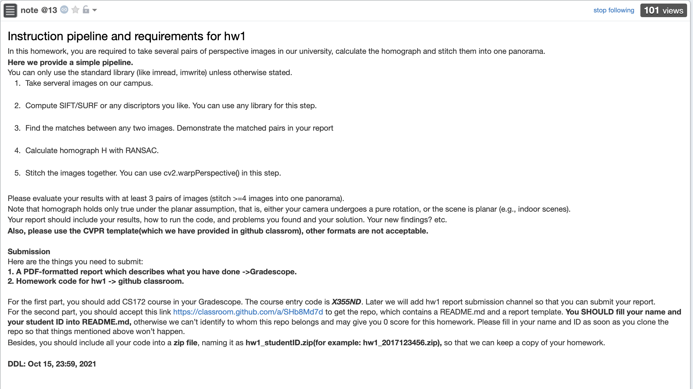

Slide 4
Outline
Introduction to Detection
Detection in the Past
Traditional methods
Basic ideas
Detection in deep learning age
Two stage algorithm
One stage algorithm
Your step to detection
Framework

Slide 5
Outline
Introduction to Detection
Detection in the Past
Traditional methods
Basic ideas
Detection in deep learning age
Two stage algorithm
One stage algorithm
Your step to detection
Framework

Slide 6
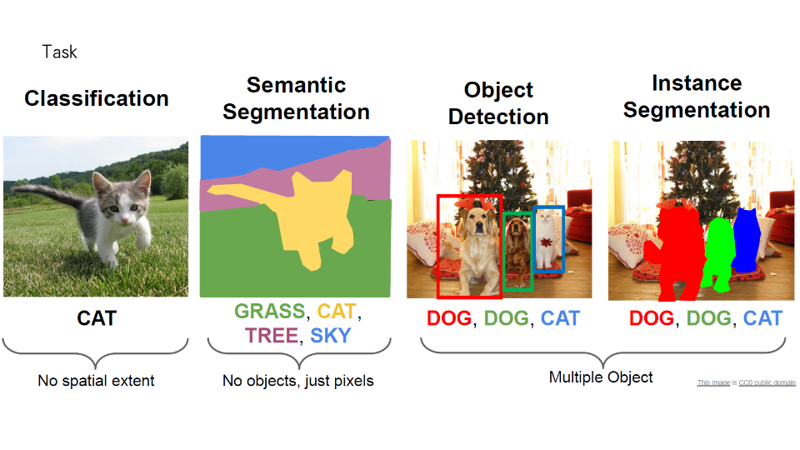

Slide 7
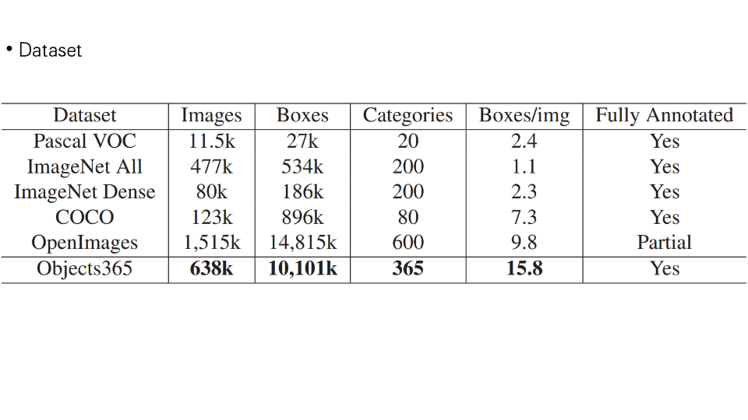
Outline
Introduction to Detection
Detection in the Past
Traditional methods
Deep learning
Details: scale, crowd, speed, ...
Industry: Face Detection
Detection Now
Upper bound, speed, few shot, more category
Industry: Human/Vehicle Detection
Detection in the Future
research directions
Industry: Autonomous driving/AR

Slide 8
Outline
Detection in the Past
Detection Now
Detection In the Future
Two stage: R-CNN Series
One stage: SSD, YOLO, RetinaNet Details: Scale, Backbone, Head, …
Upper-bound Data
How far from solving?
Feature + Classifier
Research
2013年
2020年
Industry
Face Detection
Vehicle Detection Text Detection Human Detection
General Detection

Slide 9
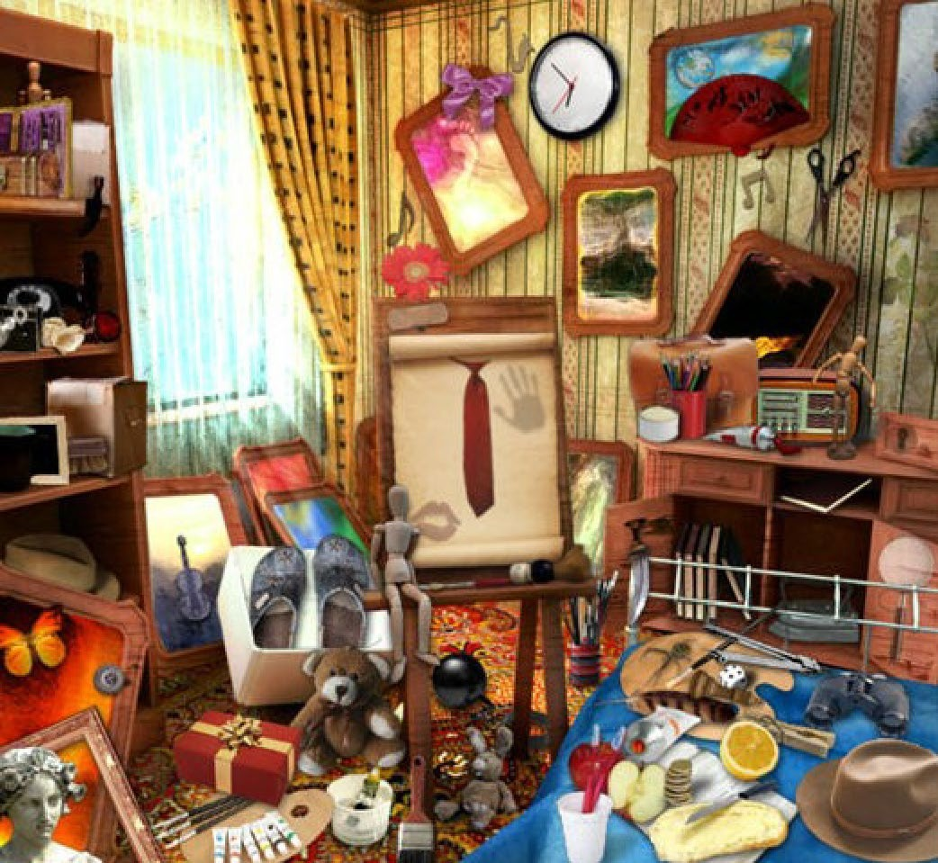
Visual Recognition
A fundamental task in computer vision
Classification
Object Detection
Semantic Segmentation
Instance Segmentation
Key point Detection
VQA
…

Slide 10
Representation
Bounding-box
Face Detection, Human Detection, Vehicle Detection, Text Detection, general Object Detection
Point
Semantic segmentation (will be discussed in next week)
Keypoint
Face landmark
Human Keypoint

Slide 11
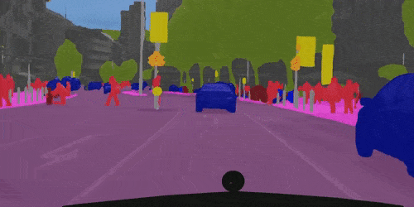
Segmentation

Slide 12
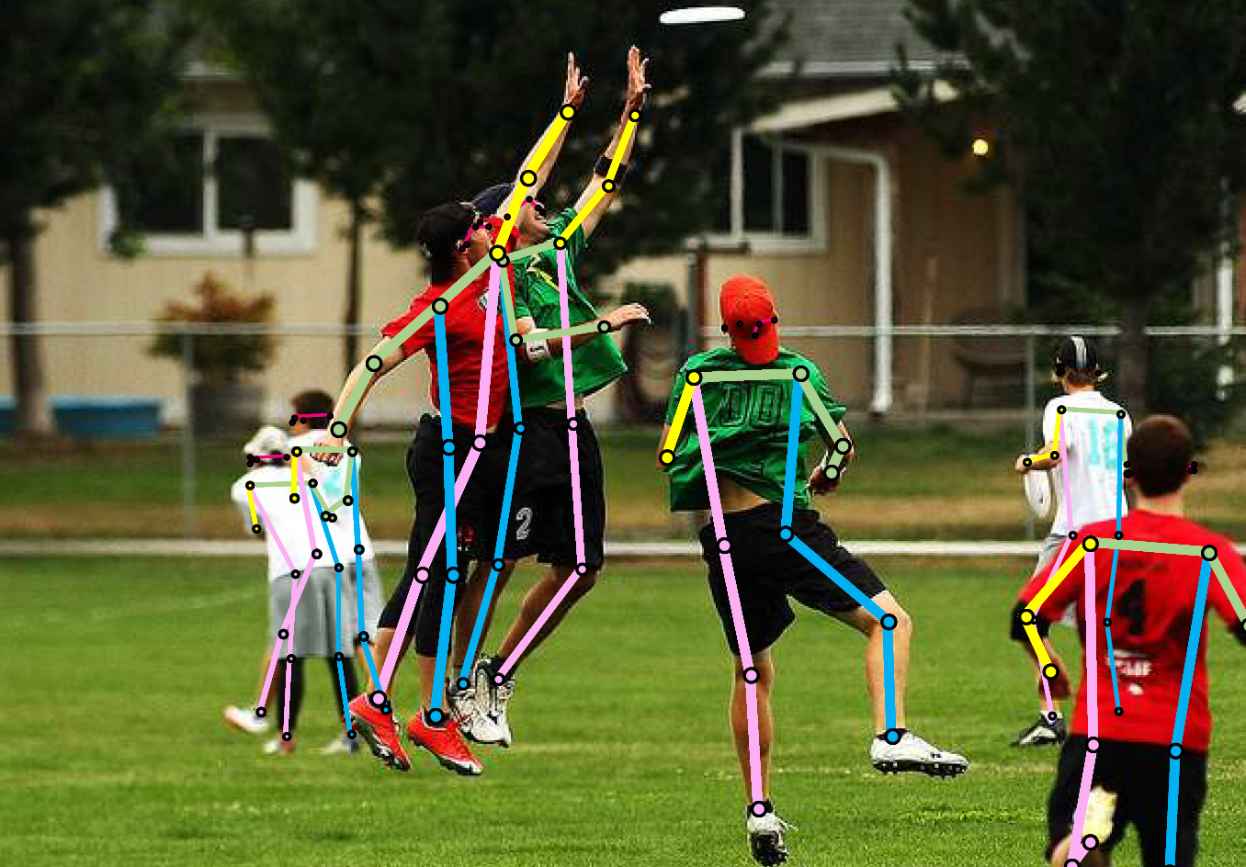
Skeleton

Slide 13

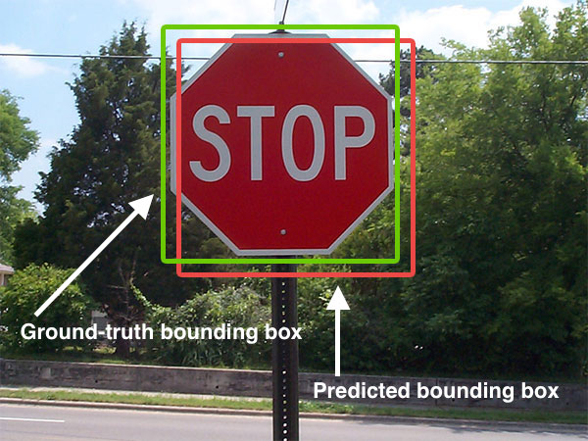
IOU(intersection of union)

Slide 14
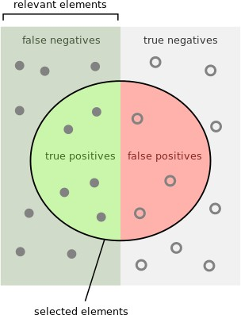
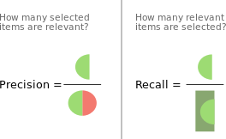
Detection - Evaluation Criteria
Average Precision (AP) and mAP
Figures are from wikipedia

Slide 15
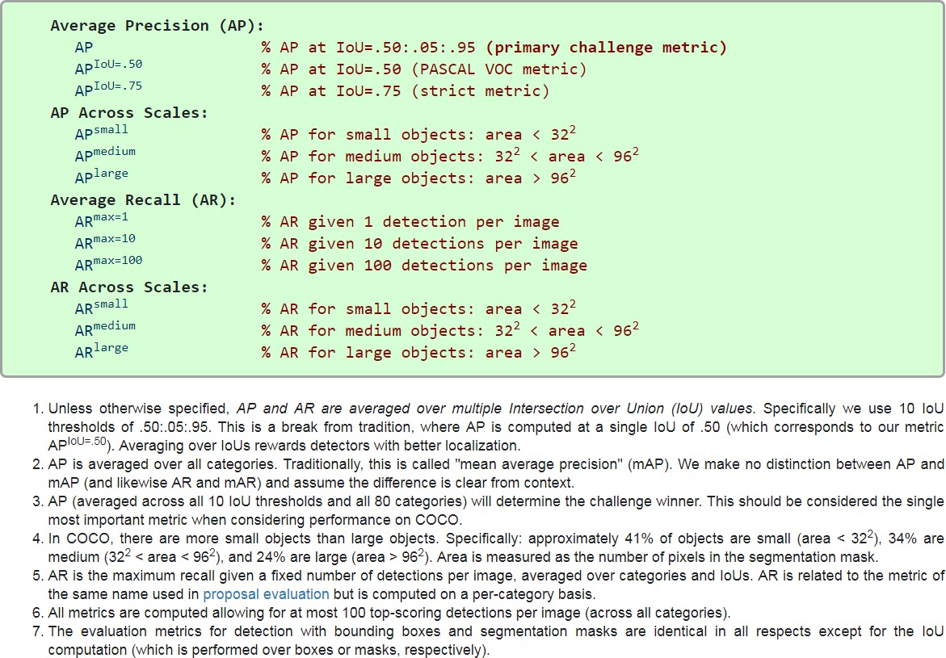
Detection - Evaluation Criteria
mmAP
Figures are from http://cocodataset.org

Slide 16
Outline
Introduction to Detection
Detection in the Past
Traditional methods
Basic ideas
Detection in deep learning age
One stage algorithm
Two stage algorithm
Your step to detection
Framework

Slide 17
Detection Before Deep Learning
Feature + classifier
Feature
Haar Feature
HOG (Histogram of Gradient)
LBP (Local Binary Pattern)
ACF (Aggregated Channel Feature)
…
Classifier
SVM
Bootsing
Random Forest

Slide 18
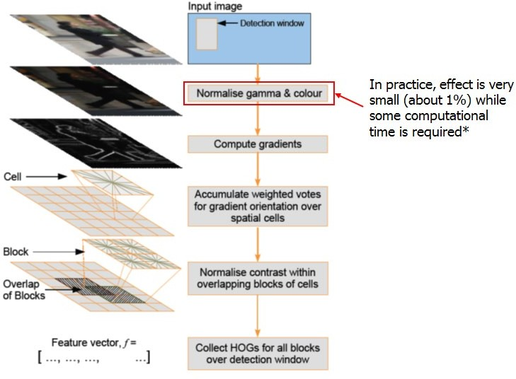
Traditional Hand-crafted Feature: HoG
histograms of oriented gradients for human detection, CVPR 2005

Slide 19
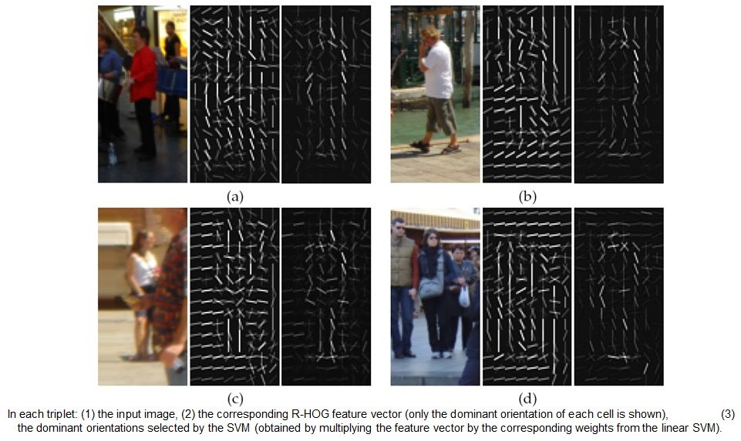
Traditional Hand-crafted Feature: HoG

Slide 20
Detection Before Deep Learning
Traditional Methods
Pros
Efficient to compute (e.g., HAAR, ACF) on CPU
Easy to debug, analyze the bad cases
reasonable performance on limited training data
Cons
Limited performance on large dataset
Hard to be accelerated by GPU

Slide 21
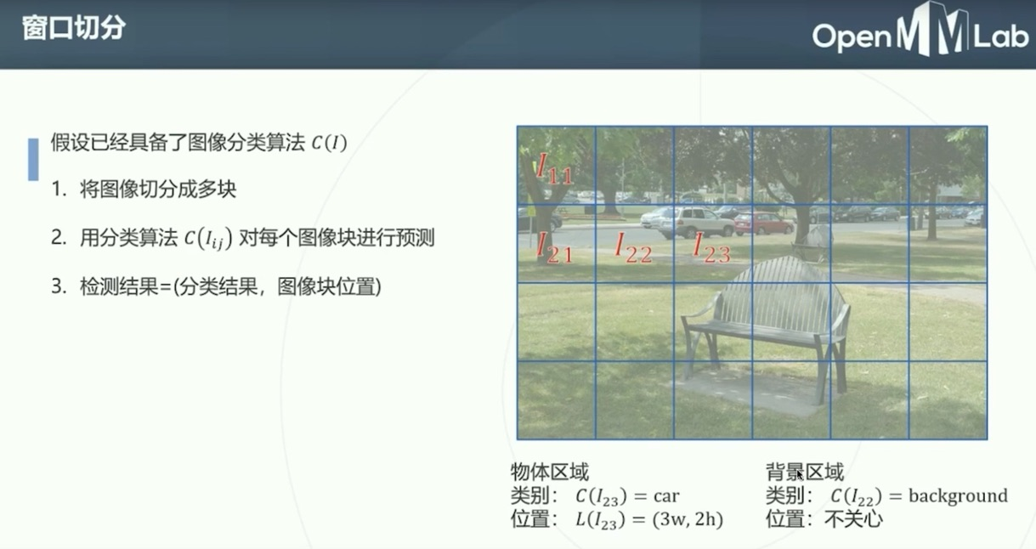

Slide 22
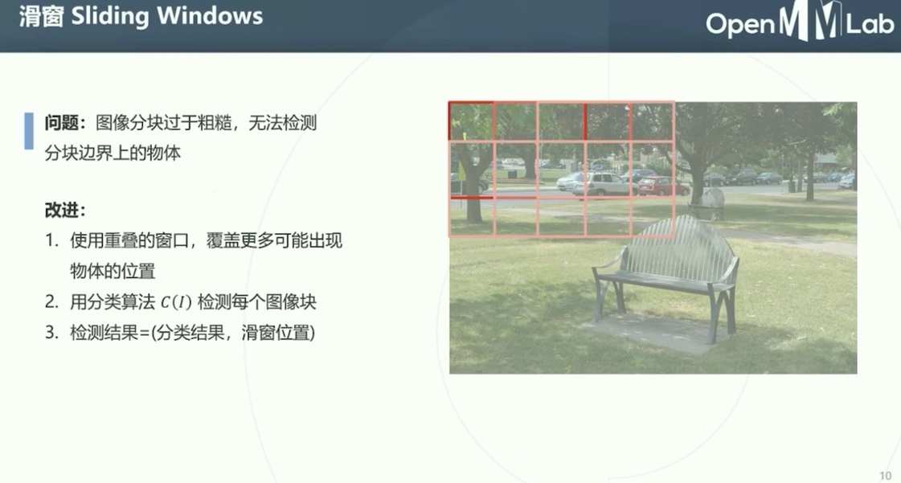

Slide 23
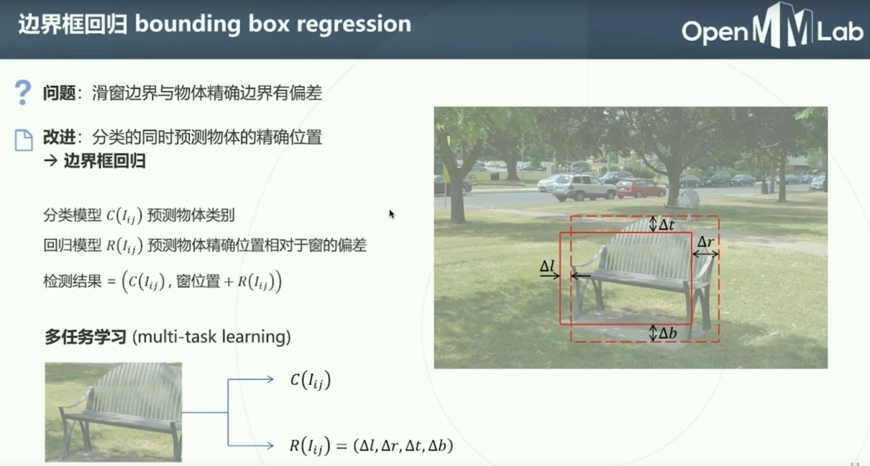

Slide 24
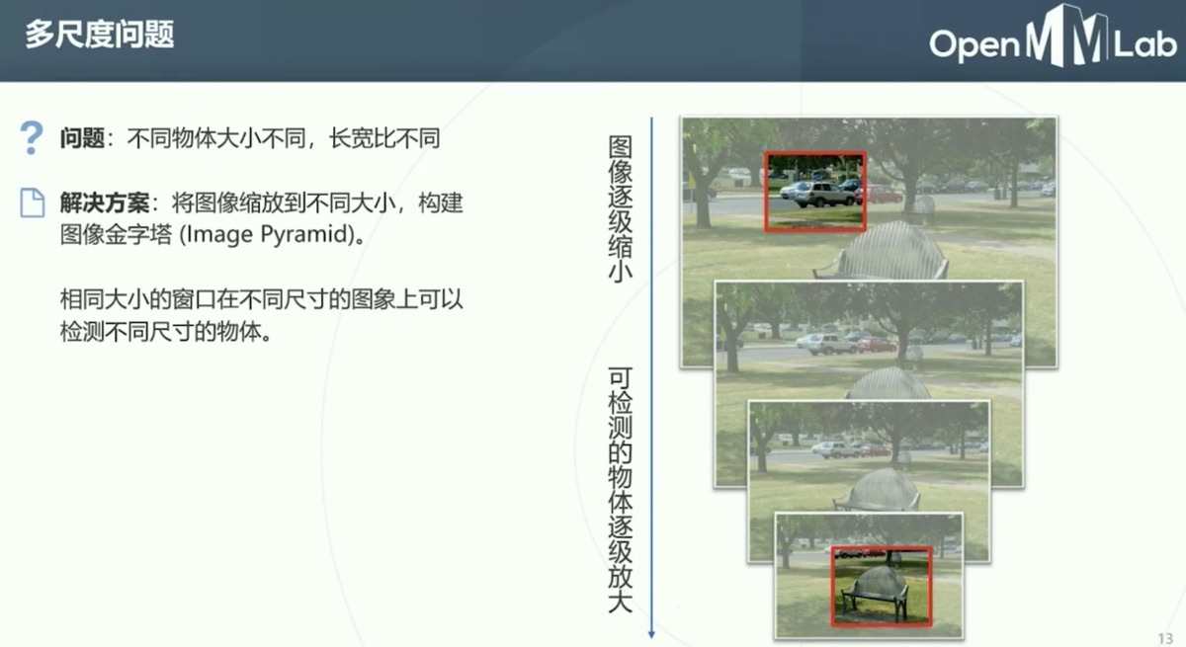

Slide 25
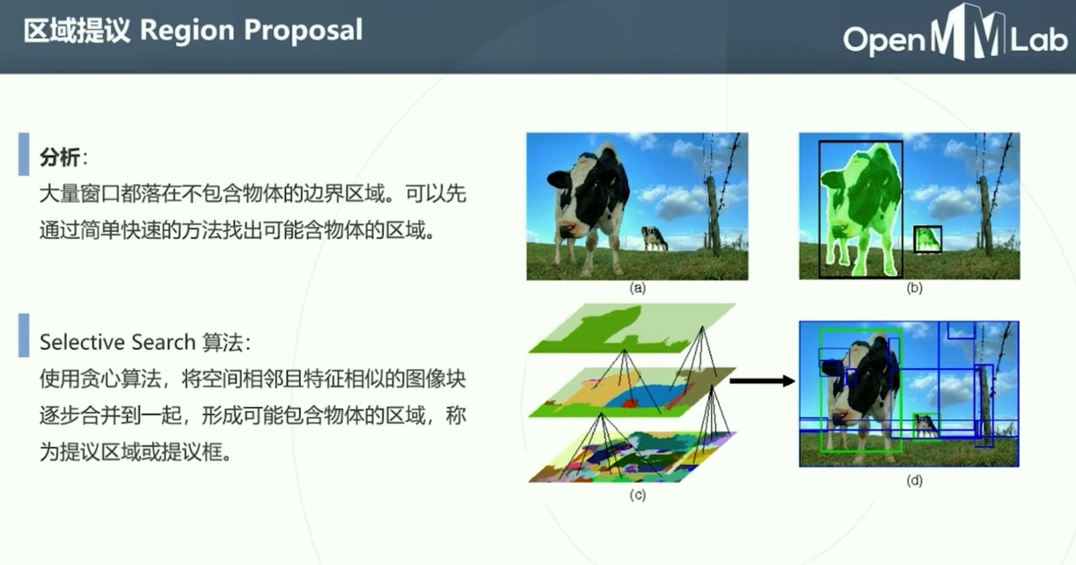

Slide 26
Outline
Introduction to Detection
Detection in the Past
Traditional methods
Basic ideas
Detection in deep learning age
One stage algorithm
Two stage algorithm
Your step to detection
Framework
Research directions

Slide 27
Deep Learning for Object Detection
Based on the whether following the “proposal and refine”
One Stage
Example: YOLO, SSD, RetinaNet
Keyword: Anchor, Divide and conquer, loss sampling
Two Stage
Example: RCNN (Fast RCNN, Faster RCNN), FPN, MaskRCNN
Keyword: speed, performance

Slide 28
A bit of History
OverFeat(2013) MultiBox(2014) Densebox (2015)
UnitBox (2016)
EAST (2017)
Feature Extractor
classification
YOLO (2015)
Anchor Free
Image
Localization(bbox)
YOLOv2 (2016)
Anchor imported
RON(2017)
SSD (2015)
RetinaNet(2017)
One stage detector
DSSD (2017)
two stages detector
RFCN++ (2017)
Feature Extractor
classification
Image
Proposal
RFCN (2016)
RCNN (2014)
Fast RCNN(2015)
Faster RCNN (2015)
Localization(bbox)
FPN (2017)
classification
Refine
Mask RCNN (2017)
Localization(bbox)

Slide 29
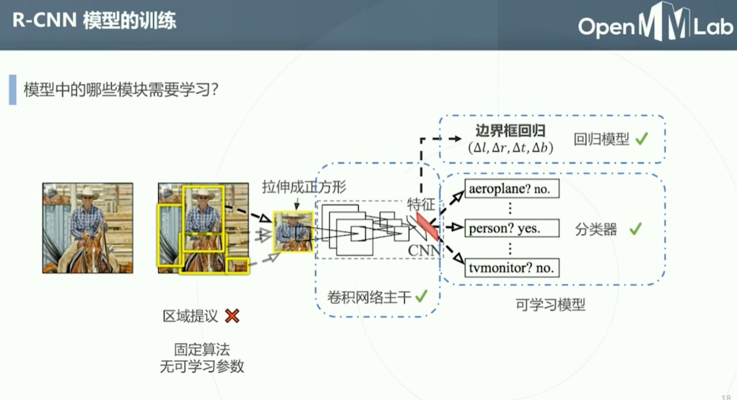

Slide 30
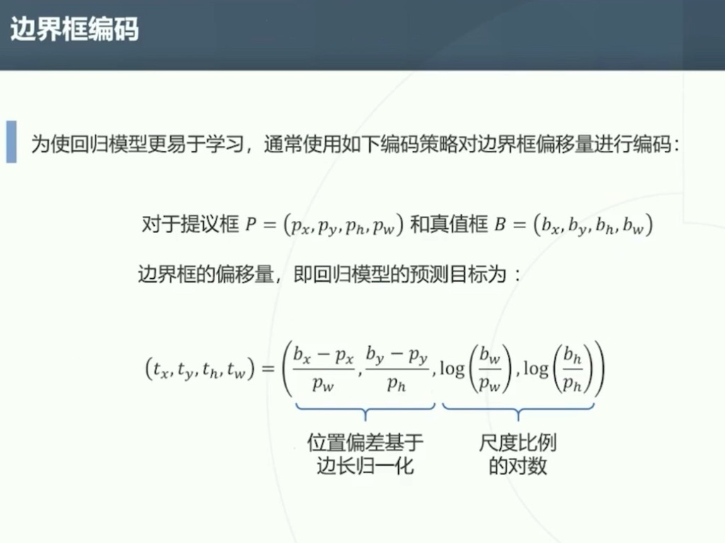

Slide 31
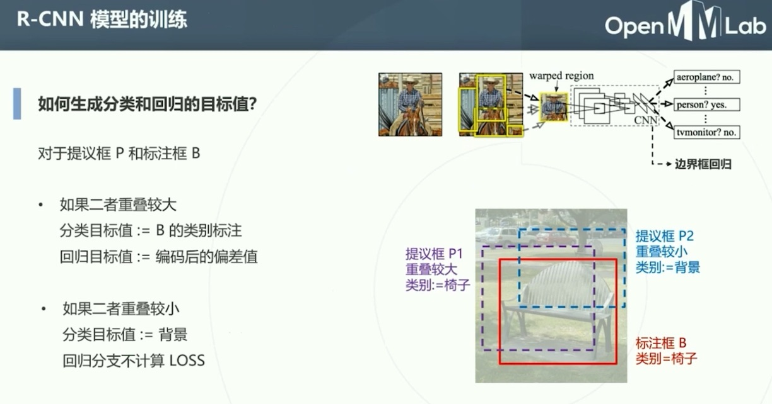

Slide 32
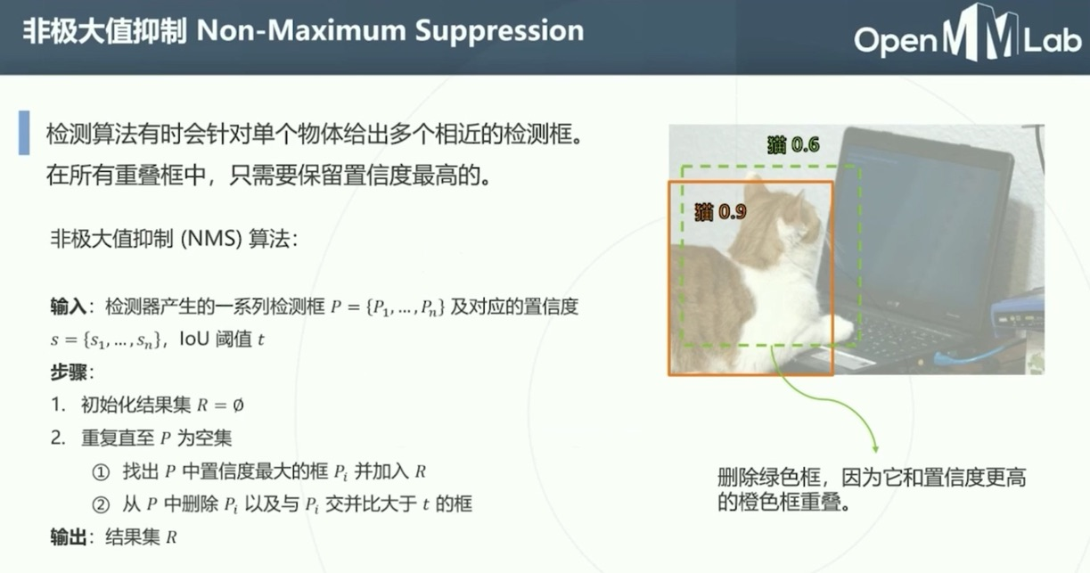

Slide 33
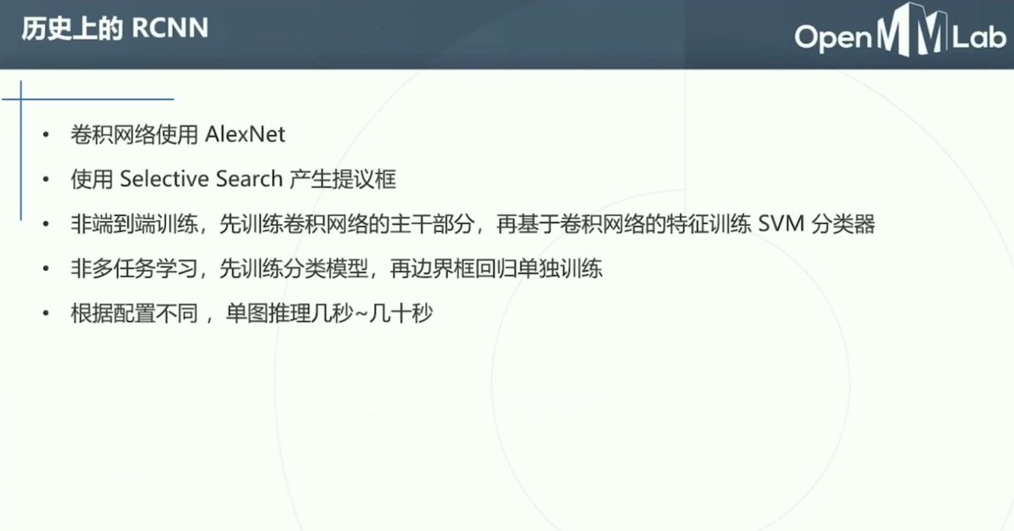

Slide 34
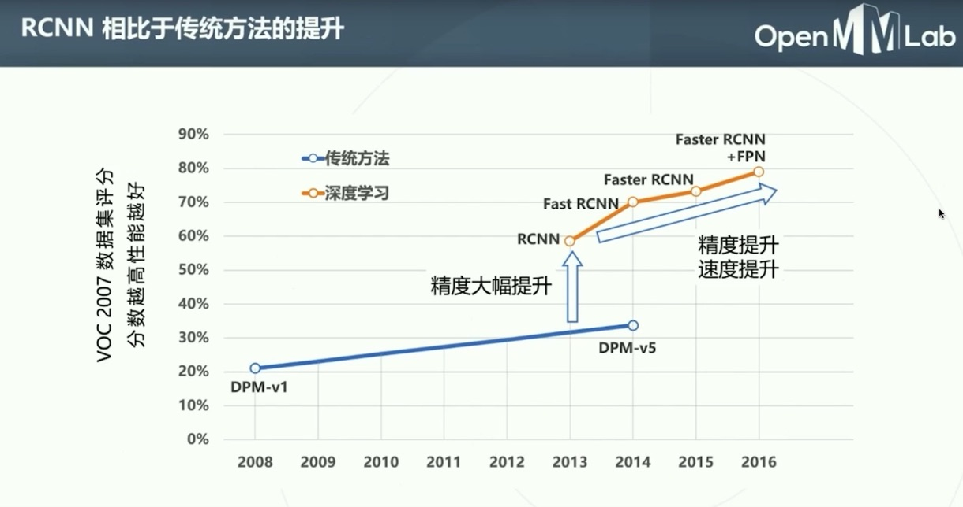

Slide 35
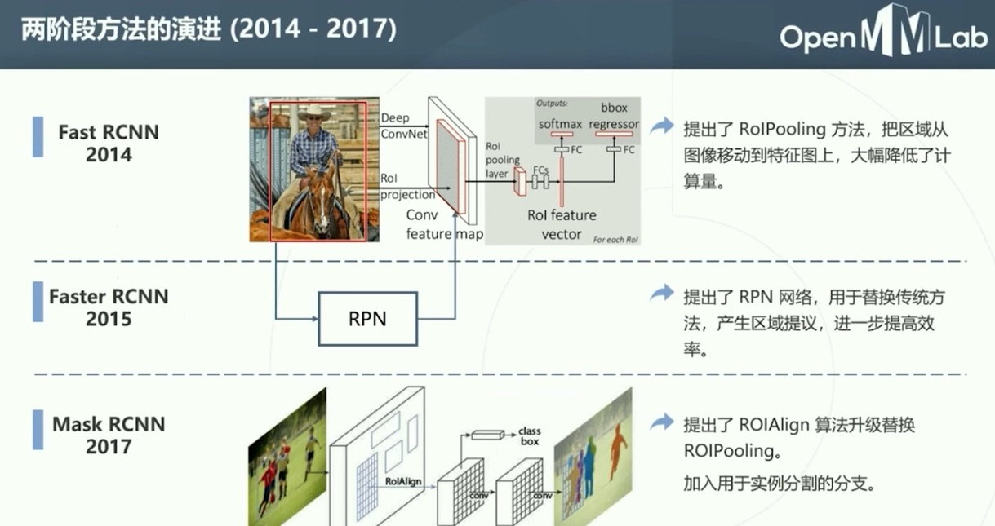

Slide 36
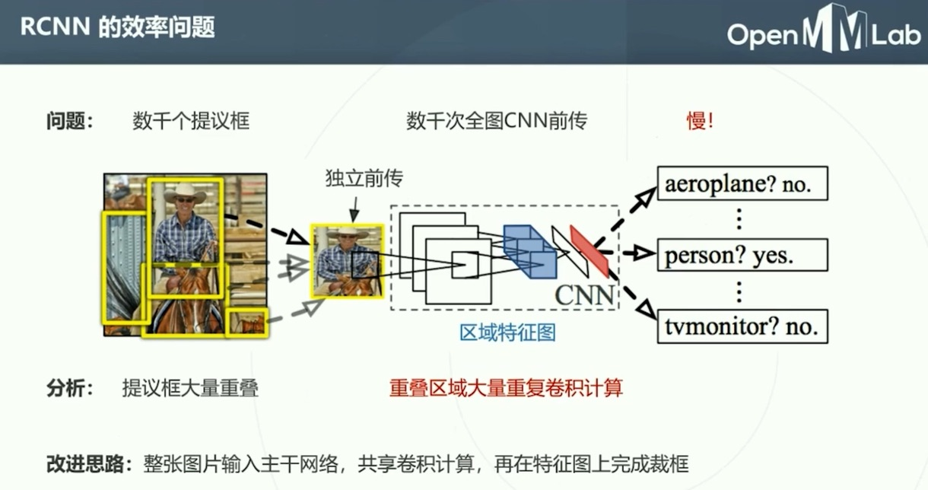

Slide 37
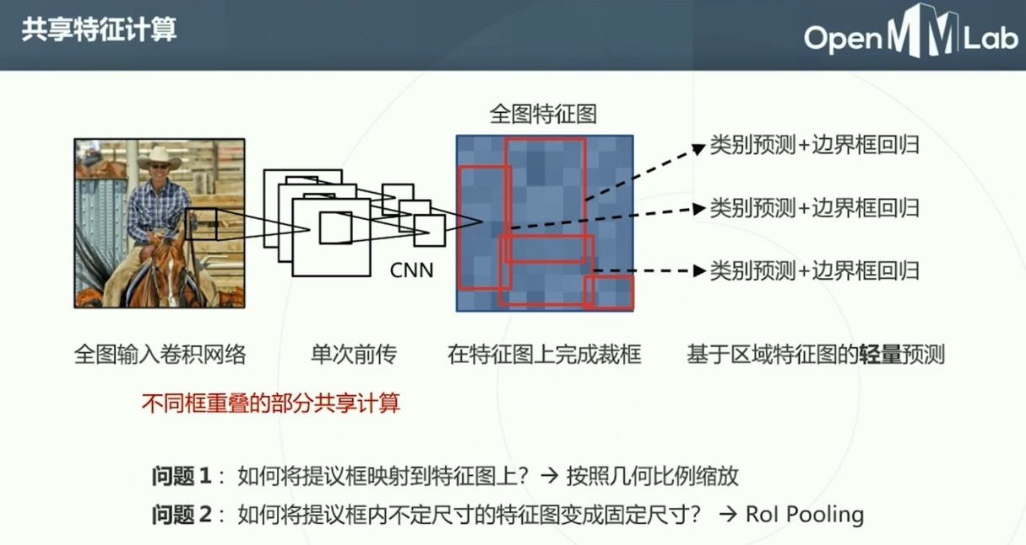

Slide 38
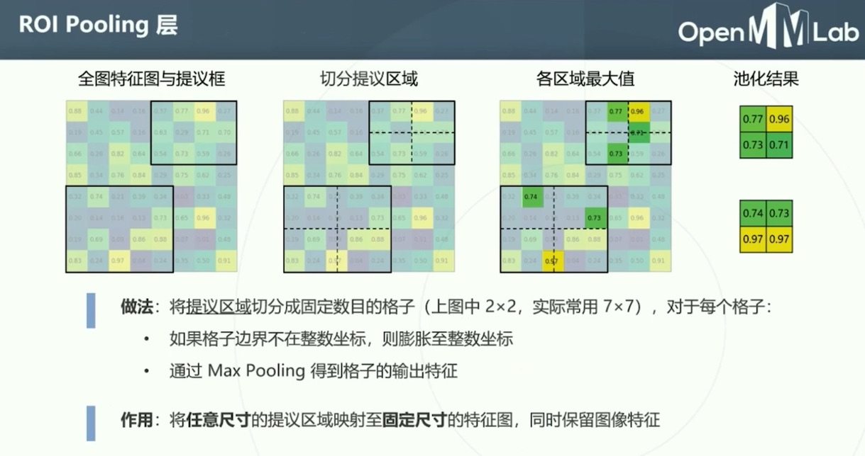

Slide 39
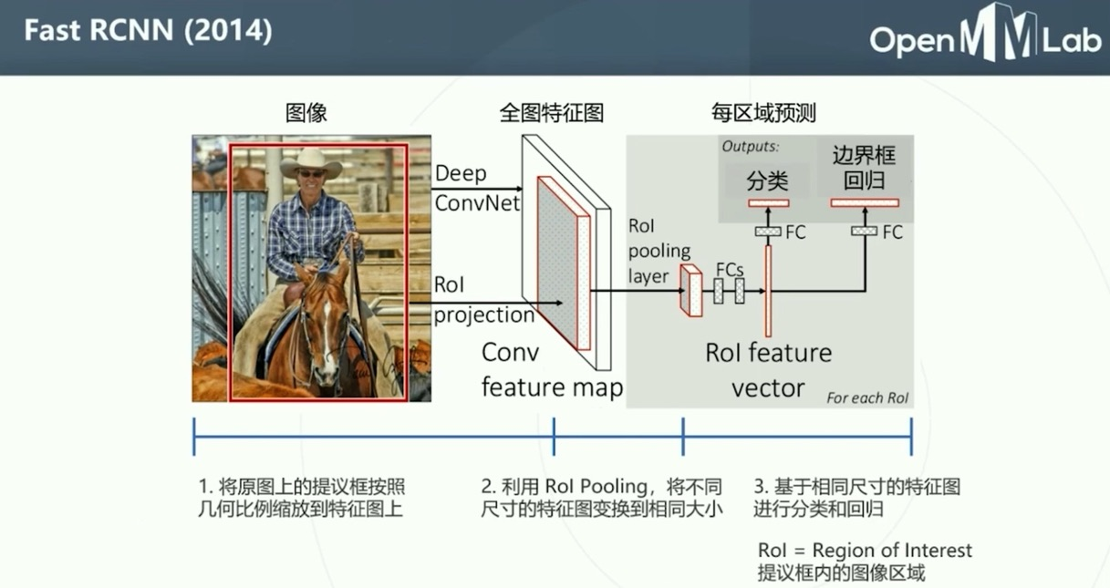

Slide 40
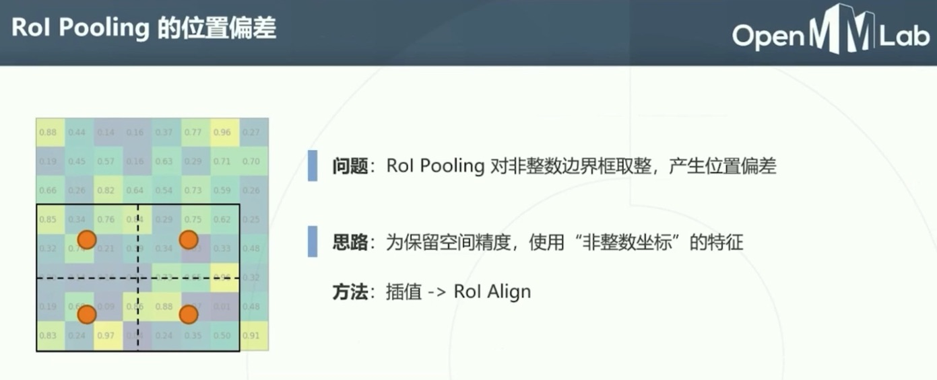

Slide 41
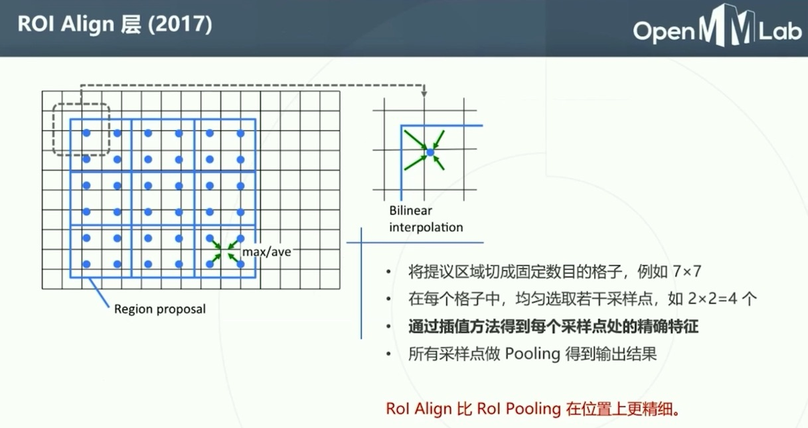

Slide 42
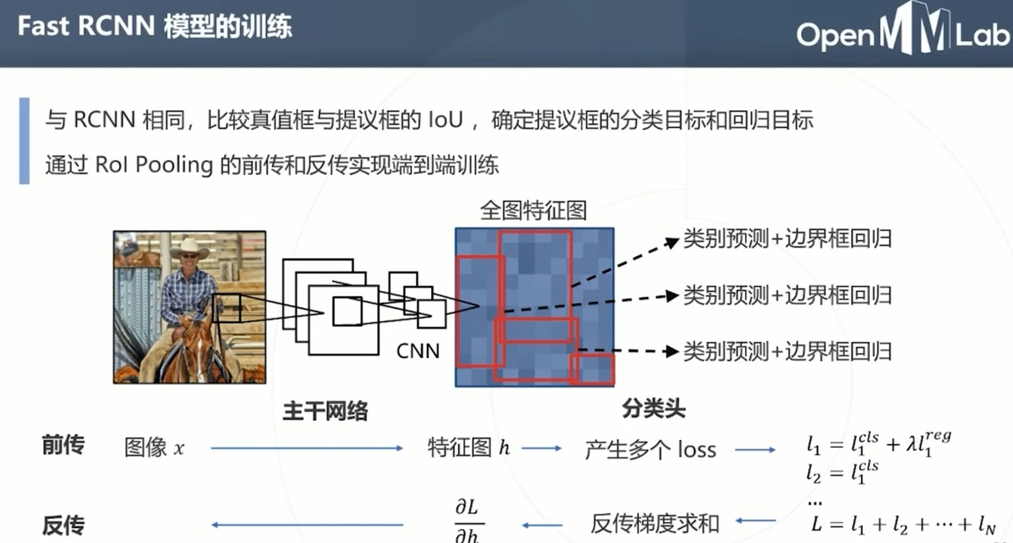

Slide 43
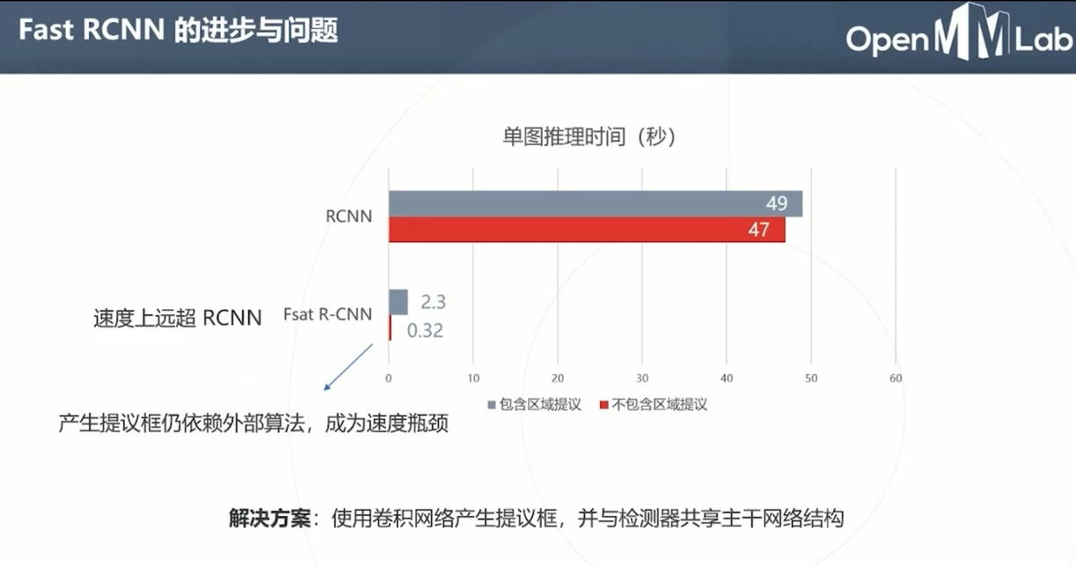

Slide 44
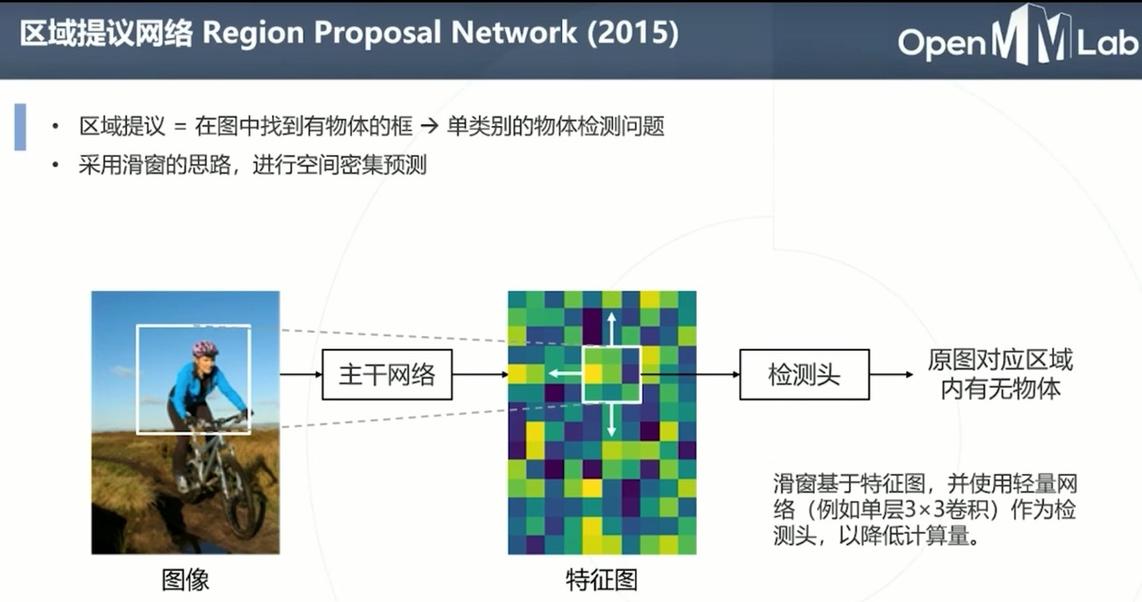

Slide 45
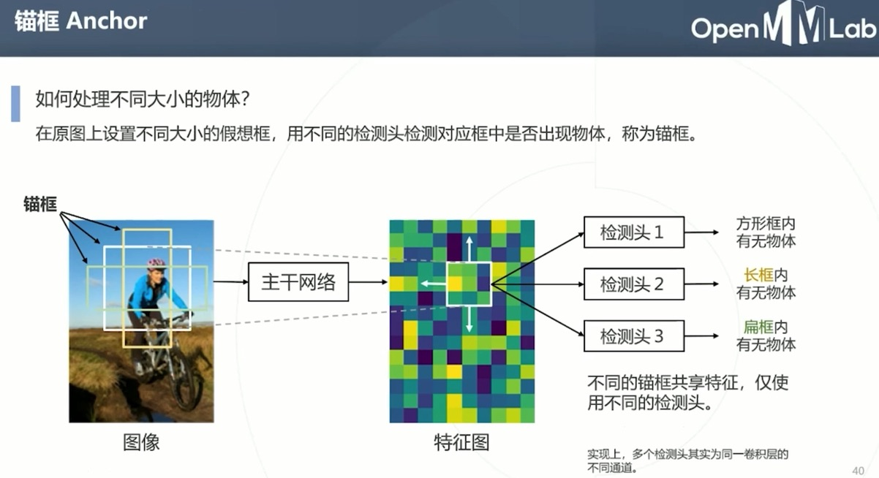

Slide 46
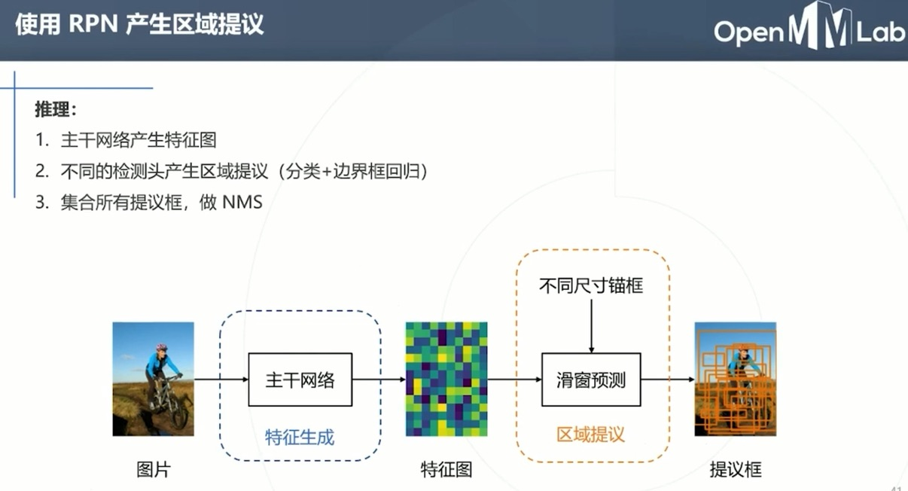

Slide 47
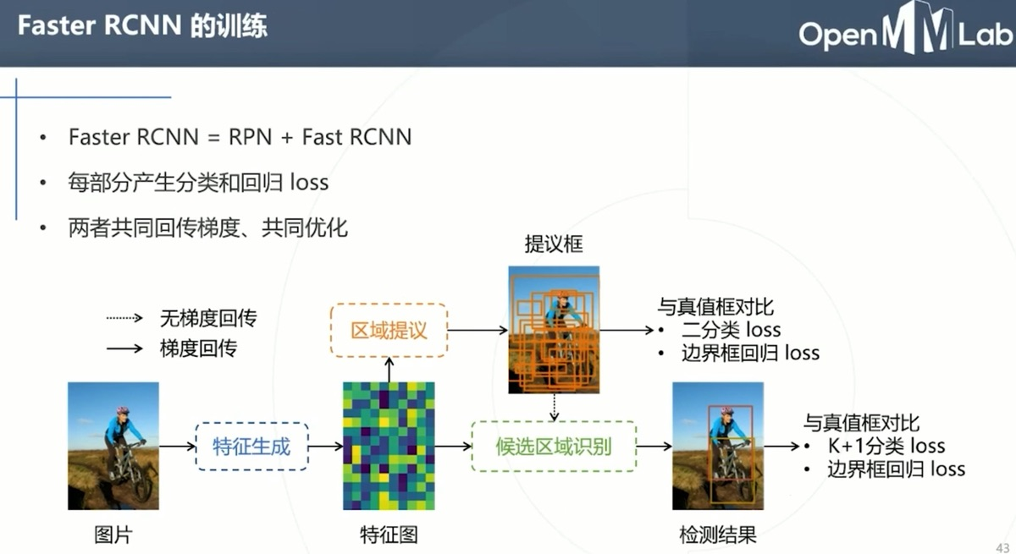

Slide 48
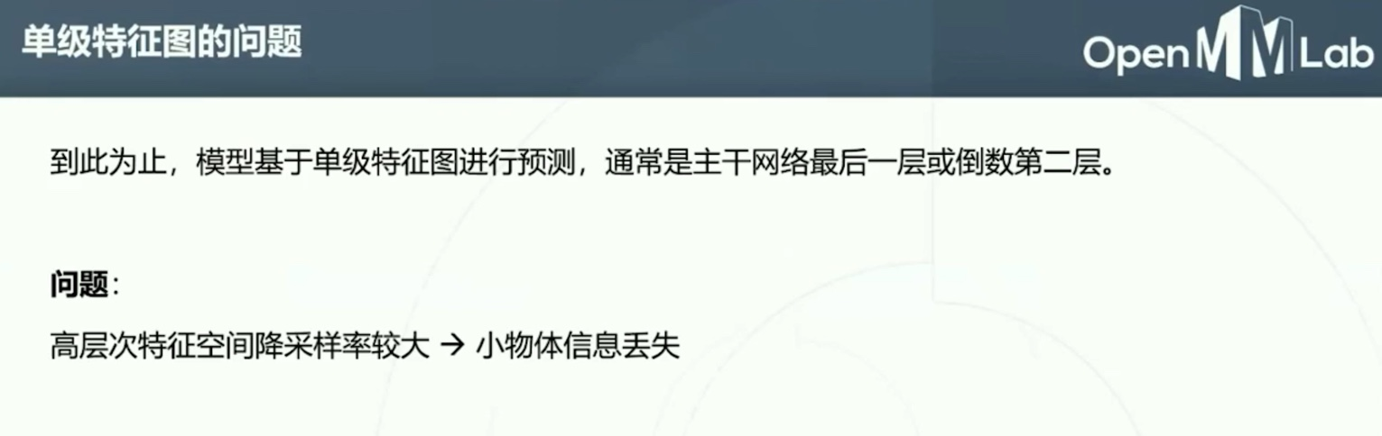
Solution 1: Using lower level network feature → leak of semantic information
Solution 2: Using feature pyramid → low efficiency
Solution 3: Fusing low level feature and high level feature → FPN

Slide 49
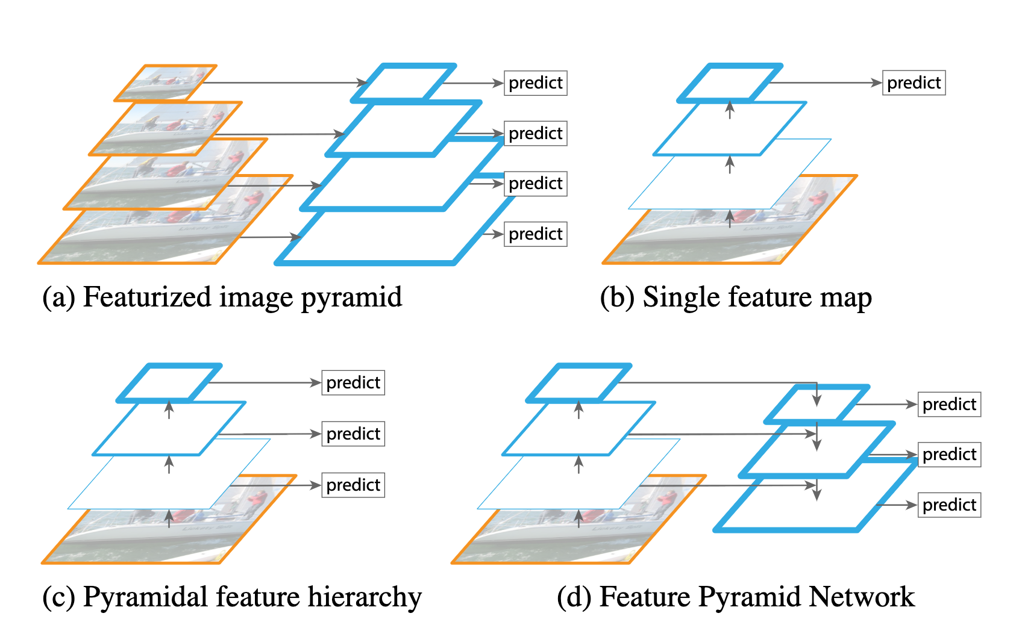

Slide 50
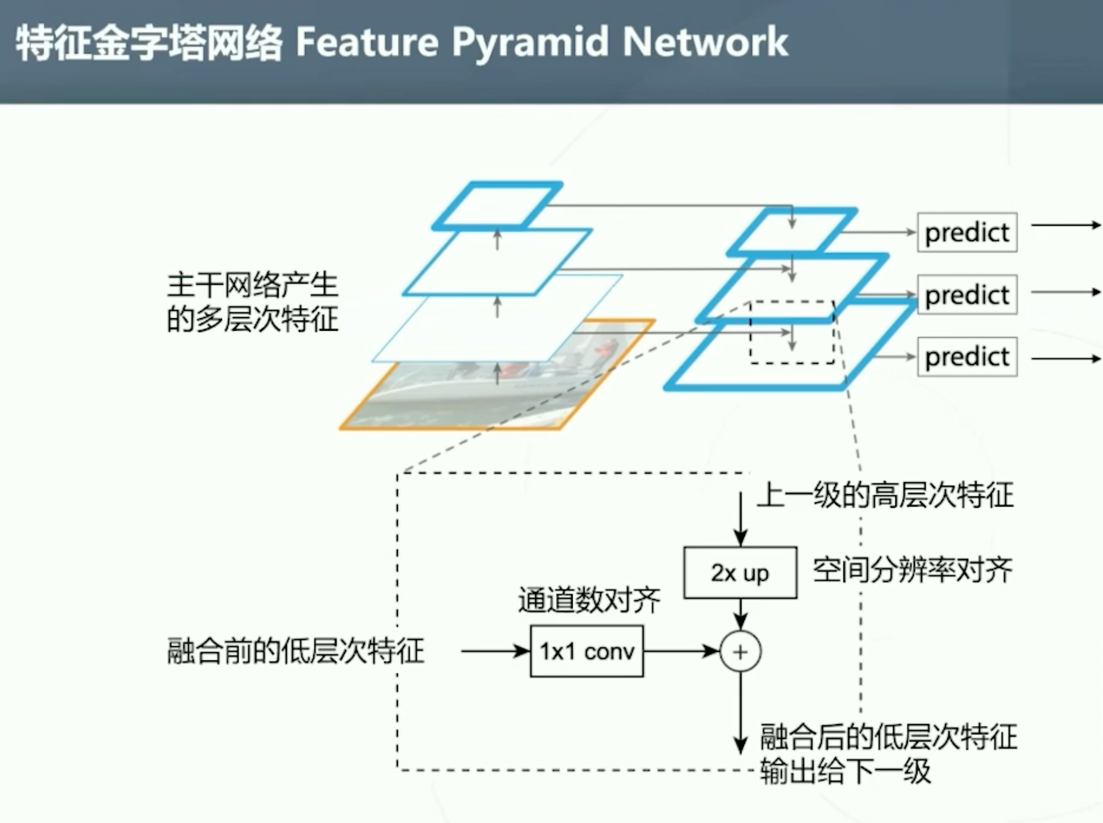

Slide 51
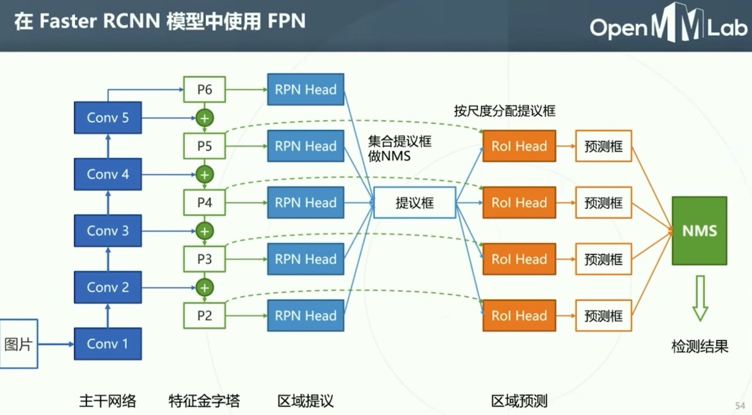

Slide 52
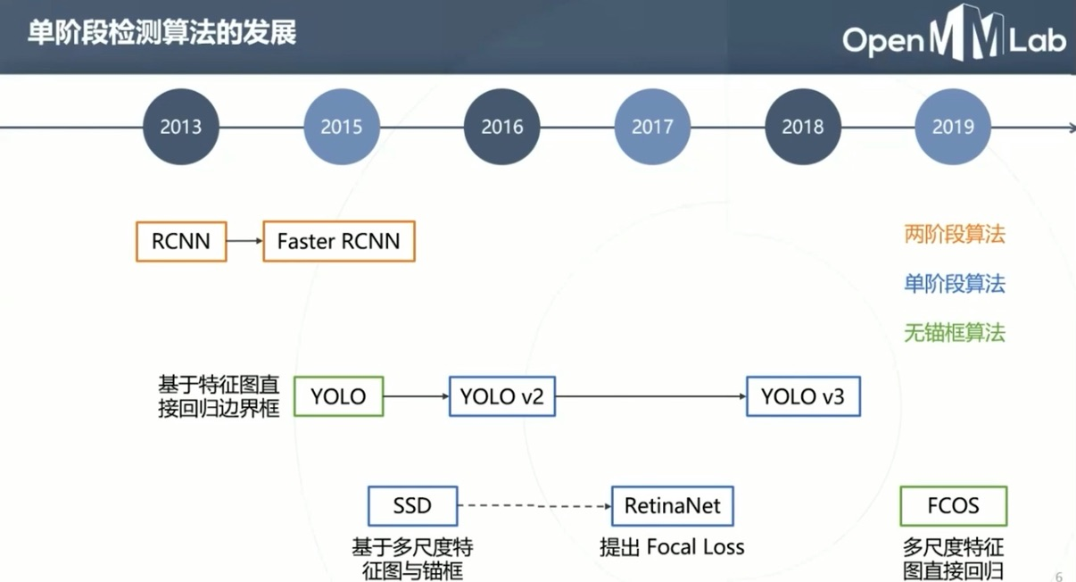

Slide 53
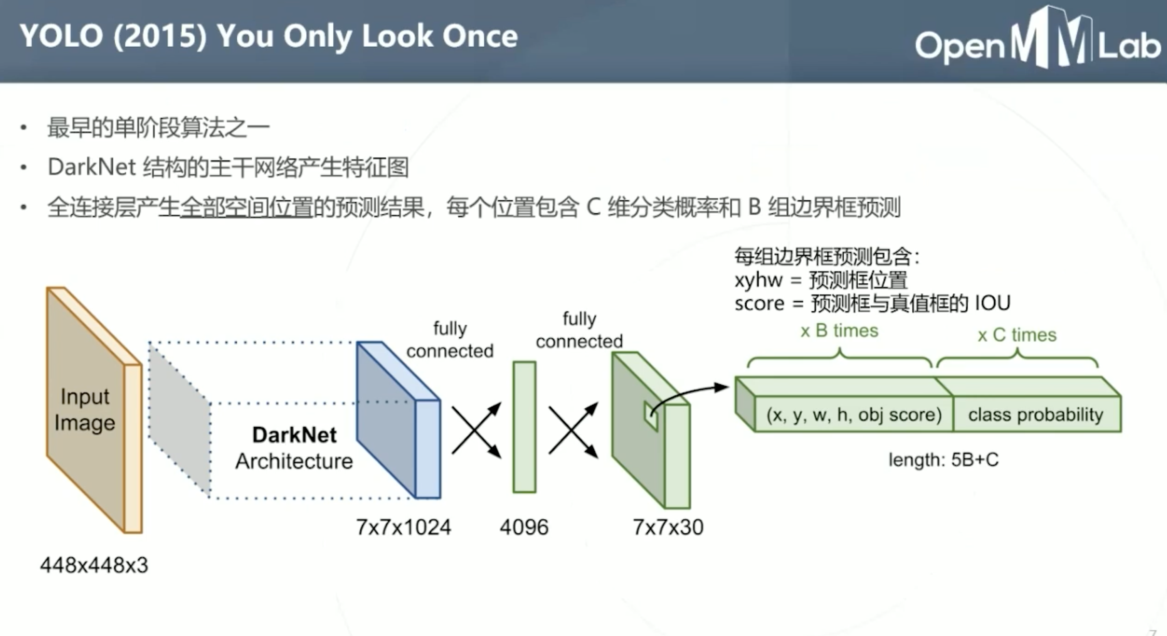

Slide 54
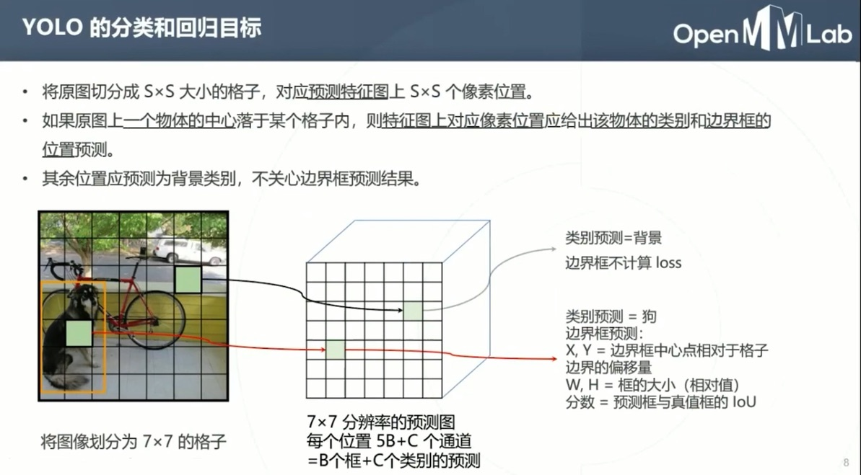

Slide 55
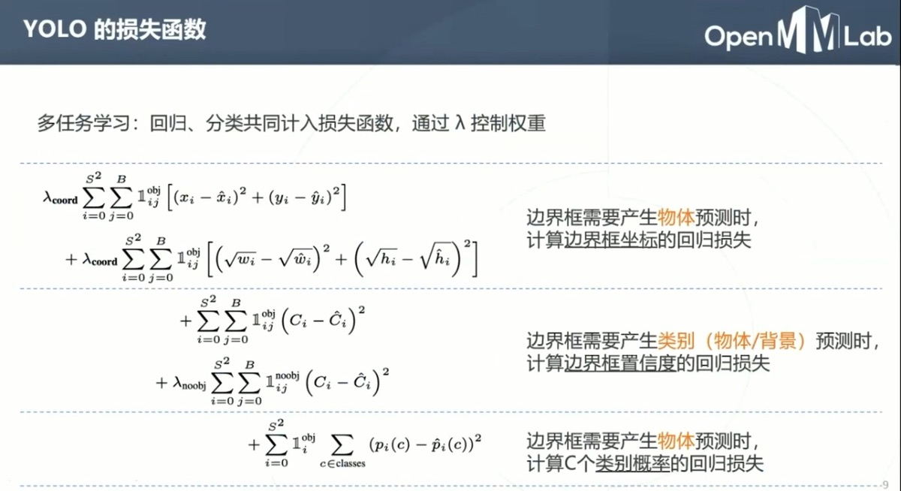

Slide 56
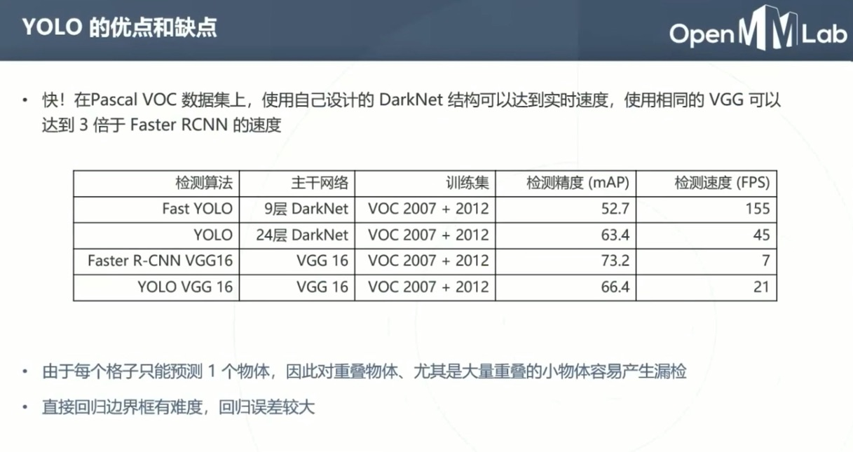

Slide 57
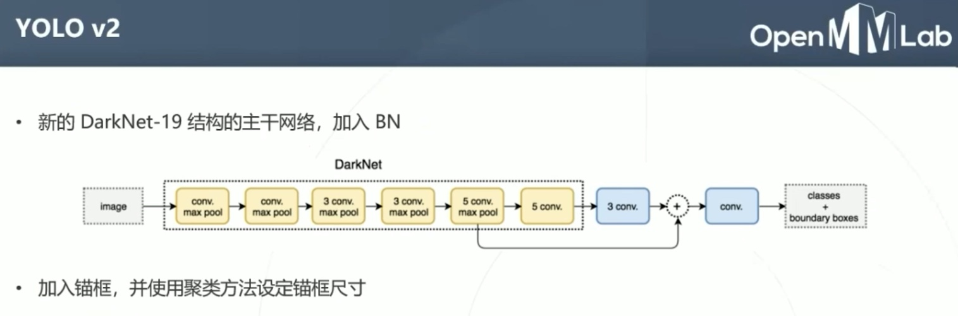
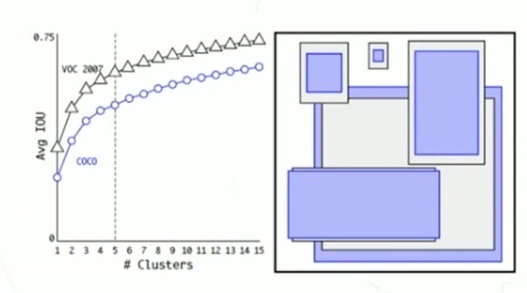

Slide 58
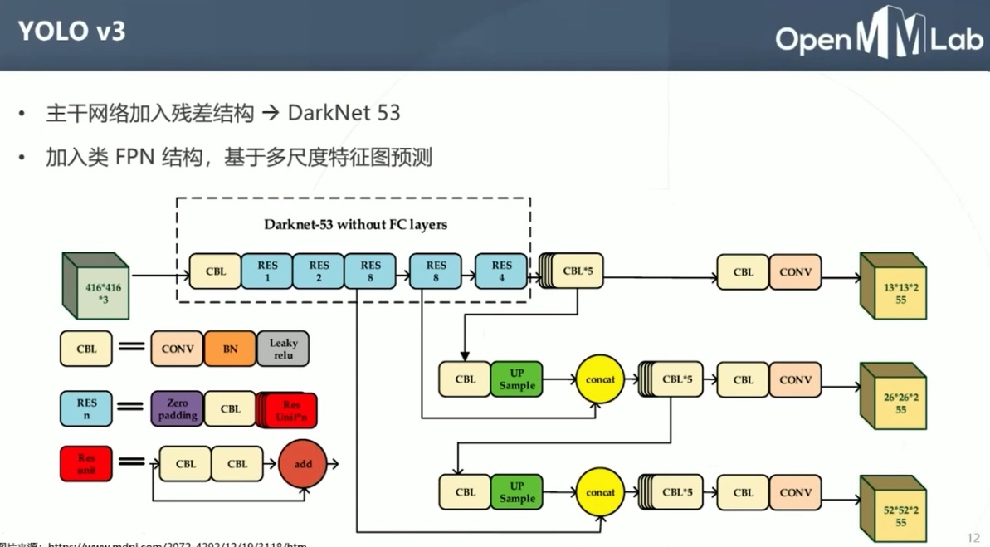

Slide 59
Outline
Introduction to Detection
Detection in the Past
Traditional methods
Basic ideas
Detection in deep learning age
One stage algorithm
Two stage algorithm
Your step to detection
Framework

Slide 60
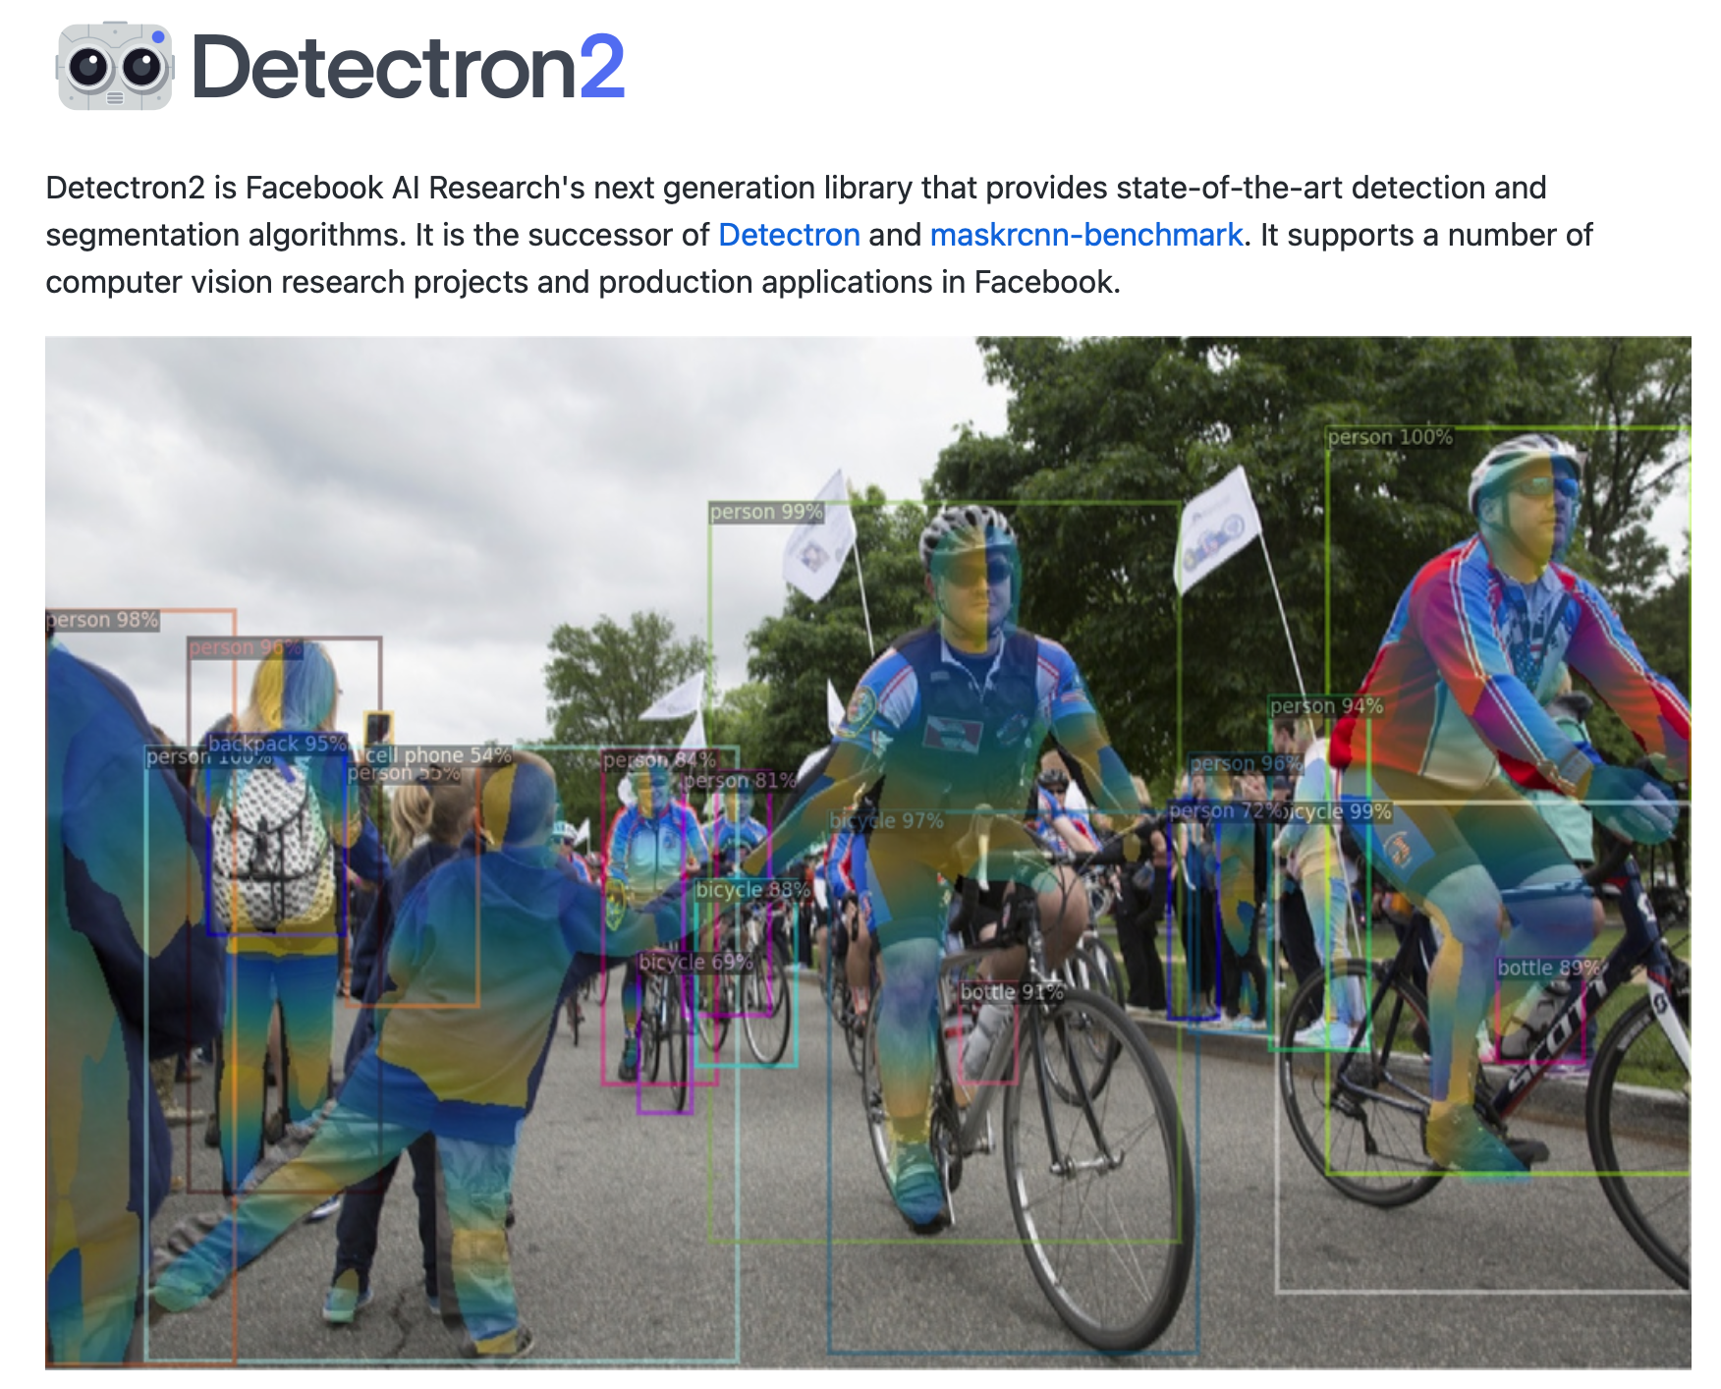
https://github.com/facebookresearch/detectron2

Slide 61
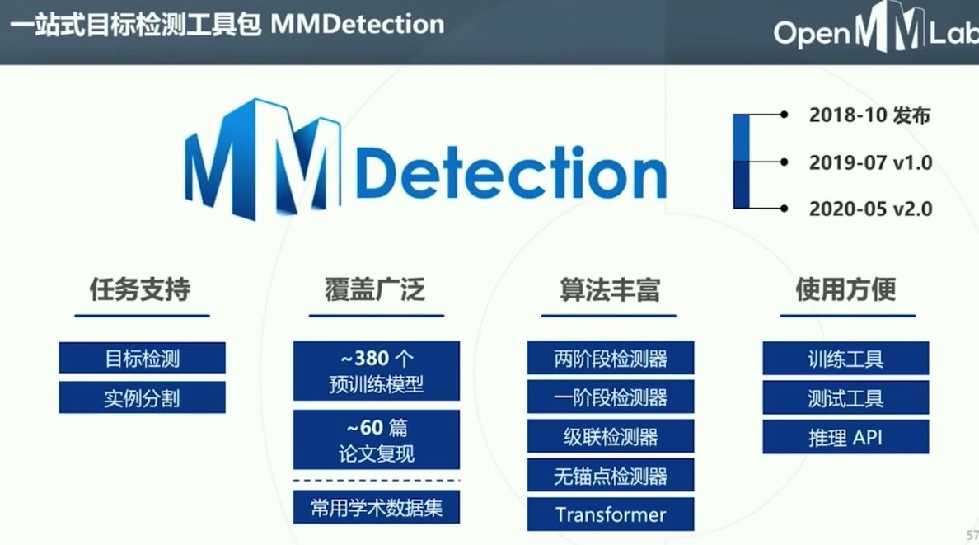
https://github.com/open-mmlab/mmdetection

Slide 62


Slide 63


